Slide 1

Advanced SQL, Streaming/Kafka
Week 8
Marilson Campos
UCSC Extension - 2020

Slide 2
1 – Advanced Hive SQL
Common Table Expressions
Complex queries can get messy.
SELECT
state,
sum(order_total) AS total_amount
FROM (
SELECT
user.user_uid,
user.user_name,
user.state as state,
inv.total AS order_total
FROM tb_orders inv
LEFT JOIN tb_user user
ON users.user_uid = inv.user_id
WHERE
users.user_uid IS NOT NULL
AND
inv.order_date = '2020-01-01'
) q1
GROUP BY q1.state
ORDER BY q1.state;

Slide 3
1 – Advanced Hive SQL
Common Table Expressions
Complex queries can get messy – Cleaned version
WITH orders_today AS
(
SELECT
user.user_uid,
user.user_name,
user.state as state,
inv.total AS order_total
FROM tb_orders inv
LEFT JOIN tb_user user
ON users.user_uid = inv.user_id
WHERE
users.user_uid IS NOT NULL
AND
inv.order_date = '2020-01-01'
)
SELECT
state,
sum(order_total) AS total_amount
FROM orders_today
GROUP BY state
ORDER BY state;

Slide 4
1 – Advanced Hive SQL
Temporary tables & Hive config variables
Sometimes you want to materialize an intermediary result.
-- This is creating a table name variable
SET temp_users=tmp_users_for_day_${hiveconf:dt_date};
DROP TABLE IF EXISTS ${hiveconf:temp_users};
CREATE TEMPORARY TABLE ${hiveconf:temp_users}
AS
SELECT
user_id,
user_name
FROM
real_table r_table
WHERE
r_ table.dt = '${hiveconf:dt_date}'
;

Slide 5
1 – Advanced Hive SQL
Macros
Reuse operations by declaring Hive macros.
CREATE TEMPORARY MACRO valid_id(user_id STRING)
(
CASE WHEN cast(user_id as int) is NULL THEN false ELSE true
end
);
select valid_id('1a');
false
select valid_id('1');
true
select valid_id(NULL);
false

Slide 6
1 – SQL Windows functions
Why we need them?
Answer questions like:
How to get the top 2 salaries of each department?
How to calculate the moving average of the last
3 measurements at each time?
List the cumulative sales for each customer by time?

Slide 7
1 – Anatomy of SQL Windows functions
SELECT
<WindowFunction> OVER <WindowSpec>
FROM <table_name>
WindowFunction =
ROW_NUMBER -> sequence of numbers 1,2,3,4
RANK, DENSE_RANK, -> ranking based on field
NTILE -> specific percentile
SUM -> cumulative sum (requires order by)
COUNT, AVG
LAG -> the value from previous record
LEAD -> the value from next record
FIRST_VALUE -> First record on partition
LAST_VALUE -> Last record on partition

Slide 8
1 – Anatomy of SQL Windows functions
SELECT
<WindowFunction> OVER <WindowSpec>
FROM <table_name>
WindowSpec =
PARTITION BY <field>
ORDER BY <field>
ROWS BETWEEN <boundary> AND <boundary>
<boundary> =
<x> PRECEDING
UNBOUNDED PRECEDING
CURRENT ROW
<x> FOLLOWING
UNBOUNDED FOLLOWING

Slide 9
2 – SQL Windows function example
The bike_rides table:
duration INT
start_time STRING
end_time STRING
start_station_number INT
start_station STRING -- Name of the station
end_station_number INT
end_station STRING -- Name of the station
bike_number STRING
member_type STRING
To load the data: Read file lab_c4_win.txt on the inside of lab_c4_win folder.

Slide 10
2 – Window spec with just ‘order’
SELECT
duration,
SUM(duration) OVER (ORDER BY start_time) AS running_total
FROM bike_rides
LIMIT 25
;
﻿1407 1407.0
202 1609.0 = 1407 + 202
519 2128.0 = 1609 + 519
522 2650.0
756 3406.0
551 3957.0
7797 11754.0
File: ex_01_with_order.sh

Slide 11
2 – Window spec with ‘order and partition’
SELECT
start_station,
duration,
SUM(duration) OVER
(PARTITION BY start_station ORDER BY start_time) AS running_total
FROM bike_rides;
﻿10th & E St NW 942 942.0 = 942 + 0
10th & E St NW 447 1389.0 = 447 + 942
10th & E St NW 1054 2443.0
. . .
10th & E St NW 1211 32987.0
10th & Florida Ave NW 472 472.0 = 472 + 0
10th & Florida Ave NW 821 1293.0 = 821 + 472
10th & Florida Ave NW 751 2044.0
10th & Florida Ave NW 1315 3359.0
10th & Florida Ave NW 1059 4418.0
File: ex_02_with_order_partition.sh

Slide 12
2 – Window spec with only ‘partition’
SELECT
start_station,
duration,
SUM(duration) OVER (PARTITION BY start_station) AS start_station_total
FROM bike_rides;
﻿
﻿10th & E St NW 860 32987.0
10th & E St NW 412 32987.0
10th & E St NW 987 32987.0
10th & E St NW 942 32987.0 = sum of values in partition
10th & Florida Ave NW 517 13321.0 = sum of values in partition 10th & Florida Ave NW 672 13321.0
10th & Florida Ave NW 751 13321.0
10th & Florida Ave NW 893 13321.0
File: ex_03_with_partition.sh

Slide 13
2 – Window with percentage of partition total
SELECT
start_station,
duration,
SUM(duration) OVER (PARTITION BY start_station) AS start_terminal_total,
round((duration/SUM(duration)
OVER (PARTITION BY start_station)) * 100, 2) AS pct_of_time
FROM bike_rides
ORDER BY start_station, pct_of_time
; ﻿
﻿10th & E St NW 2191 32987.0 6.64
10th & E St NW 2526 32987.0 7.66
10th & E St NW 3335 32987.0 10.11
10th & E St NW 7084 32987.0 21.48
10th & Florida Ave NW 118 13321.0 0.89
10th & Florida Ave NW 294 13321.0 2.21
10th & Florida Ave NW 419 13321.0 3.15
10th & Florida Ave NW 472 13321.0 3.54
10th & Florida Ave NW 517 13321.0 3.88
File: ex_04_2_win.sh

Slide 14
2 – Row number on each start_station
SELECT
start_station,
start_time,
duration,
ROW_NUMBER() OVER
(PARTITION BY start_station ORDER BY start_time) AS row_number
FROM bike_rides
; ﻿
﻿10th & E St NW 2018-01-28 17:17:56 791 25
10th & E St NW 2018-01-29 15:46:25 630 26
10th & E St NW 2018-01-30 17:34:53 798 27
10th & E St NW 2018-01-31 15:38:12 1211 28
10th & Florida Ave NW 2018-01-01 14:55:34 472 1
10th & Florida Ave NW 2018-01-02 07:13:39 821 2
10th & Florida Ave NW 2018-01-10 07:48:49 751 3
10th & Florida Ave NW 2018-01-10 13:14:26 1315 4
10th & Florida Ave NW 2018-01-12 08:15:30 1059 5
File: ex_05_row_num.sh

Slide 15
2 – First 2 rides for each_station
SELECT *
FROM (
SELECT
start_station, start_time, duration,
ROW_NUMBER() OVER
(PARTITION BY start_station ORDER BY start_time) AS row_number
FROM bike_rides
) q1
WHERE row_number < 3; ﻿
﻿10th & Monroe St NE 2018-01-02 18:16:02 157 1
10th & Monroe St NE 2018-01-07 16:19:17 894 2
10th & U St NW 2018-01-05 20:19:50 412 1
10th & U St NW 2018-01-08 23:22:07 290 2
10th St & Constitution Ave NW 2018-01-02 09:49:08 1937 1
10th St & Constitution Ave NW 2018-01-02 15:50:59 761 2
10th St & L'Enfant Plaza SW 2018-01-02 18:11:25 1318 1
10th St & L'Enfant Plaza SW 2018-01-05 17:07:49 1616 2
11th & F St NW 2018-01-04 07:12:44 196 1
11th & F St NW 2018-01-07 09:12:32 134 2
File: ex_06_top_by_grp.sh

Slide 16
2 – Ranking by minutes
SELECT
start_station,
duration,
SUBSTRING(start_time, 1, 13) as time_slot,
RANK() OVER
(PARTITION BY start_station ORDER BY SUBSTRING(start_time, 1, 13)) AS rank
FROM bike_rides;
﻿10th & E St NW 942 2018-01-03 00 1
10th & E St NW 447 2018-01-06 16 2
10th & E St NW 412 2018-01-08 14 3
10th & E St NW 1054 2018-01-08 14 3
10th & E St NW 503 2018-01-11 00 5 <- there is no rank 4.
10th & E St NW 2191 2018-01-11 15 6
10th & E St NW 2526 2018-01-12 13 7
10th & E St NW 390 2018-01-12 16 8
10th & E St NW 334 2018-01-15 15 9
10th & E St NW 563 2018-01-16 18 10
10th & E St NW 1925 2018-01-17 18 11
File: ex_07_rank.sh

Slide 17
2 – Dense ranking by minutes
SELECT
start_station,
duration,
SUBSTRING(start_time, 1, 13) as time_slot,
DENSE_RANK() OVER
(PARTITION BY start_station ORDER BY SUBSTRING(start_time, 1, 13)) AS rank
FROM bike_rides;
﻿10th & E St NW 942 2018-01-03 00 1
10th & E St NW 447 2018-01-06 16 2
10th & E St NW 412 2018-01-08 14 3
10th & E St NW 1054 2018-01-08 14 3
10th & E St NW 503 2018-01-11 00 4 <- Dense does not skip.
10th & E St NW 2191 2018-01-11 15 5
10th & E St NW 2526 2018-01-12 13 6
10th & E St NW 390 2018-01-12 16 7
10th & E St NW 334 2018-01-15 15 8
10th & E St NW 563 2018-01-16 18 9
10th & E St NW 1925 2018-01-17 18 10
10th & E St NW 1068 2018-01-18 14 11
File: ex_08_dense_rank.sh

Slide 18
2 – The variation of duration between rides.
SELECT
start_station,
duration,
duration - LAG(duration, 1) OVER
(PARTITION BY start_station ORDER BY duration) AS delta
FROM bike_rides;
﻿10th & E St NW 1054 NULL <- first row does not have lag.
10th & E St NW 1068 14.0
10th & E St NW 1211 143.0
10th & E St NW 1925 714.0
10th & E St NW 2191 266.0
10th & E St NW 2526 335.0
10th & E St NW 3335 809.0
10th & E St NW 334 -3001.0
10th & E St NW 381 47.0
10th & E St NW 381 0.0
10th & E St NW 390 9.0
10th & E St NW 401 11.0
10th & E St NW 412 11.0
File: ex_09_lag.sh

Slide 19
2 – Collecting previous and next record.
SELECT
start_station, duration,
LAG(duration) OVER window_spec AS prev,
LEAD(duration) OVER window_spec AS next
FROM bike_rides
ORDER BY start_station, duration
WINDOW window_spec AS (PARTITION BY start_station ORDER BY duration)
Station Curr Last Next
﻿10th & E St NW 818 798 823
10th & E St NW 823 818 860
10th & E St NW 860 823 942
10th & E St NW 942 860 983
10th & E St NW 983 942 987
10th & E St NW 987 983 NULL <- No next on last rec
10th & Florida Ave NW 1039 NULL 1059 <- No previous on first rec.
10th & Florida Ave NW 1059 1039 1068
10th & Florida Ave NW 1068 1059 118
10th & Florida Ave NW 118 1068 1315
10th & Florida Ave NW 1315 118 294
10th & Florida Ave NW 294 1315 419
File: ex_10_lead_lag.sh

Slide 20
2 – Specifying custom window.
SELECT
start_station, duration,
SUM(duration) OVER window_spec AS tot
FROM bike_rides
ORDER BY start_station, duration
WINDOW window_spec AS (PARTITION BY start_station ORDER BY duration
ROWS BETWEEN UNBOUNDED PRECEDING AND 1 PRECEDING);
﻿10th & E St NW 1054 NULL
10th & E St NW 1068 1054.0 = 1054
10th & E St NW 1211 2122.0 = 1054 + 1068
10th & E St NW 1925 3333.0 = 1054 + 1068 + 1211
10th & E St NW 2191 5258.0
10th & E St NW 2526 7449.0
10th & E St NW 3335 9975.0
10th & E St NW 334 13310.0
10th & E St NW 381 13644.0
10th & E St NW 381 14025.0
10th & E St NW 390 14406.0
File: ex_11_win_size.sh

Slide 21
2 – Sum of the 2 previous records.
SELECT
start_station, duration,
SUM(duration) OVER window_spec AS tot
FROM bike_rides
ORDER BY start_station, duration
WINDOW window_spec AS (PARTITION BY start_station ORDER BY duration
ROWS BETWEEN 2 PRECEDING AND 1 PRECEDING)
﻿10th & E St NW 1054 NULL
10th & E St NW 1068 1054.0 = 1054
10th & E St NW 1211 2122.0 = 1054 + 1068
10th & E St NW 1925 2279.0.= 1068 + 1211
10th & E St NW 2191 3136.0 = 1211 + 1925
10th & E St NW 2526 4116.0
10th & E St NW 3335 4717.0
10th & E St NW 334 5861.0
10th & E St NW 381 3669.0
10th & E St NW 381 715.0
10th & E St NW 390 762.0
10th & E St NW 401 771.0
File: x_12_win_size2.sh

Slide 22

3 – Real time streaming
- Flexible Publish-subscribe/queue
- Robust Replication
- Ordering Preserved at topic partition level

Slide 23

3 – Real time streaming
Recommended reference
Written by one of the creators of Kafka.
Currently CTO at Confluent.io

Slide 24
3 – Kafka Marketplace
Apache Kafka – open source
Confluent.io – Apache Kafka as a Service
Amazon MKS – Amazon Apache Kafka as a service

Slide 25
3 – Real time streaming
Use cases
1. Process events in real-time.
2. Most often you need to capture them in real-time
and have the option to analyze some of these events in real-time.
Examples of event sources:
IOT Sensors
Microservice calls
Http calls
etc.

Slide 26
3 – Real time streaming
Realtime Consumers
Spark Streaming
Storm
Apache Flink
Kinesis
Kinesis / Analytics
Batch consumers
Hadoop HDFS
Aws S3
HBase
Cassandra

Slide 27
3 – Decoupling from consumer and producers.
- Producers can write faster than consumers for sometime.
- Writes cannot be at higher sustained rate or we run out of space.
- Kafka acts like a reliable system to capture events and deliver some time later to consumers.

Slide 28
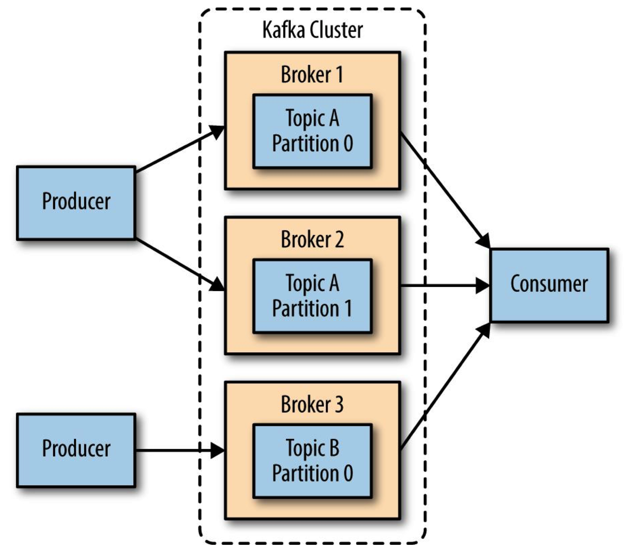
3 – Kafka – Cluster components

Slide 29
3 – Kafka - Terminology
Records
have a key (optional), value and timestamp; Immutable
Topic
is a stream of records (“/email_sent”, “/user_signups”)
Topic Log
is the storage for messages for a topic. It consist of Partitions
and spread to multiple files on multiple nodes.
Partition
parts of Topic Log
Producer API
is used to produce a streams or records
Consumer API
is used to consume a stream of records

Slide 30
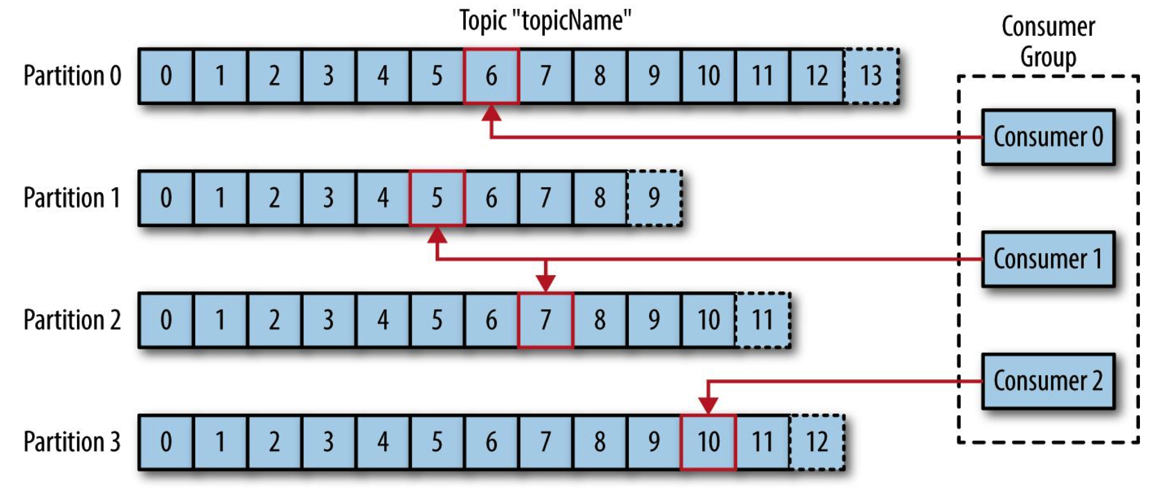
3 – Kafka - Consumption

Slide 31
3 – Kafka - Terminology
Brokers
are Kafka workers and run in a Kafka Cluster.
ZooKeeper
System that coordinates brokers/cluster operation and leadership election
Records
have a key (optional), value and timestamp and are Immutable
Producers
write to Topics
append records at end of Topic log
Consumers
read from Topics
can read from Kafka at their own pace
tracks offset from where they left off reading

Slide 32
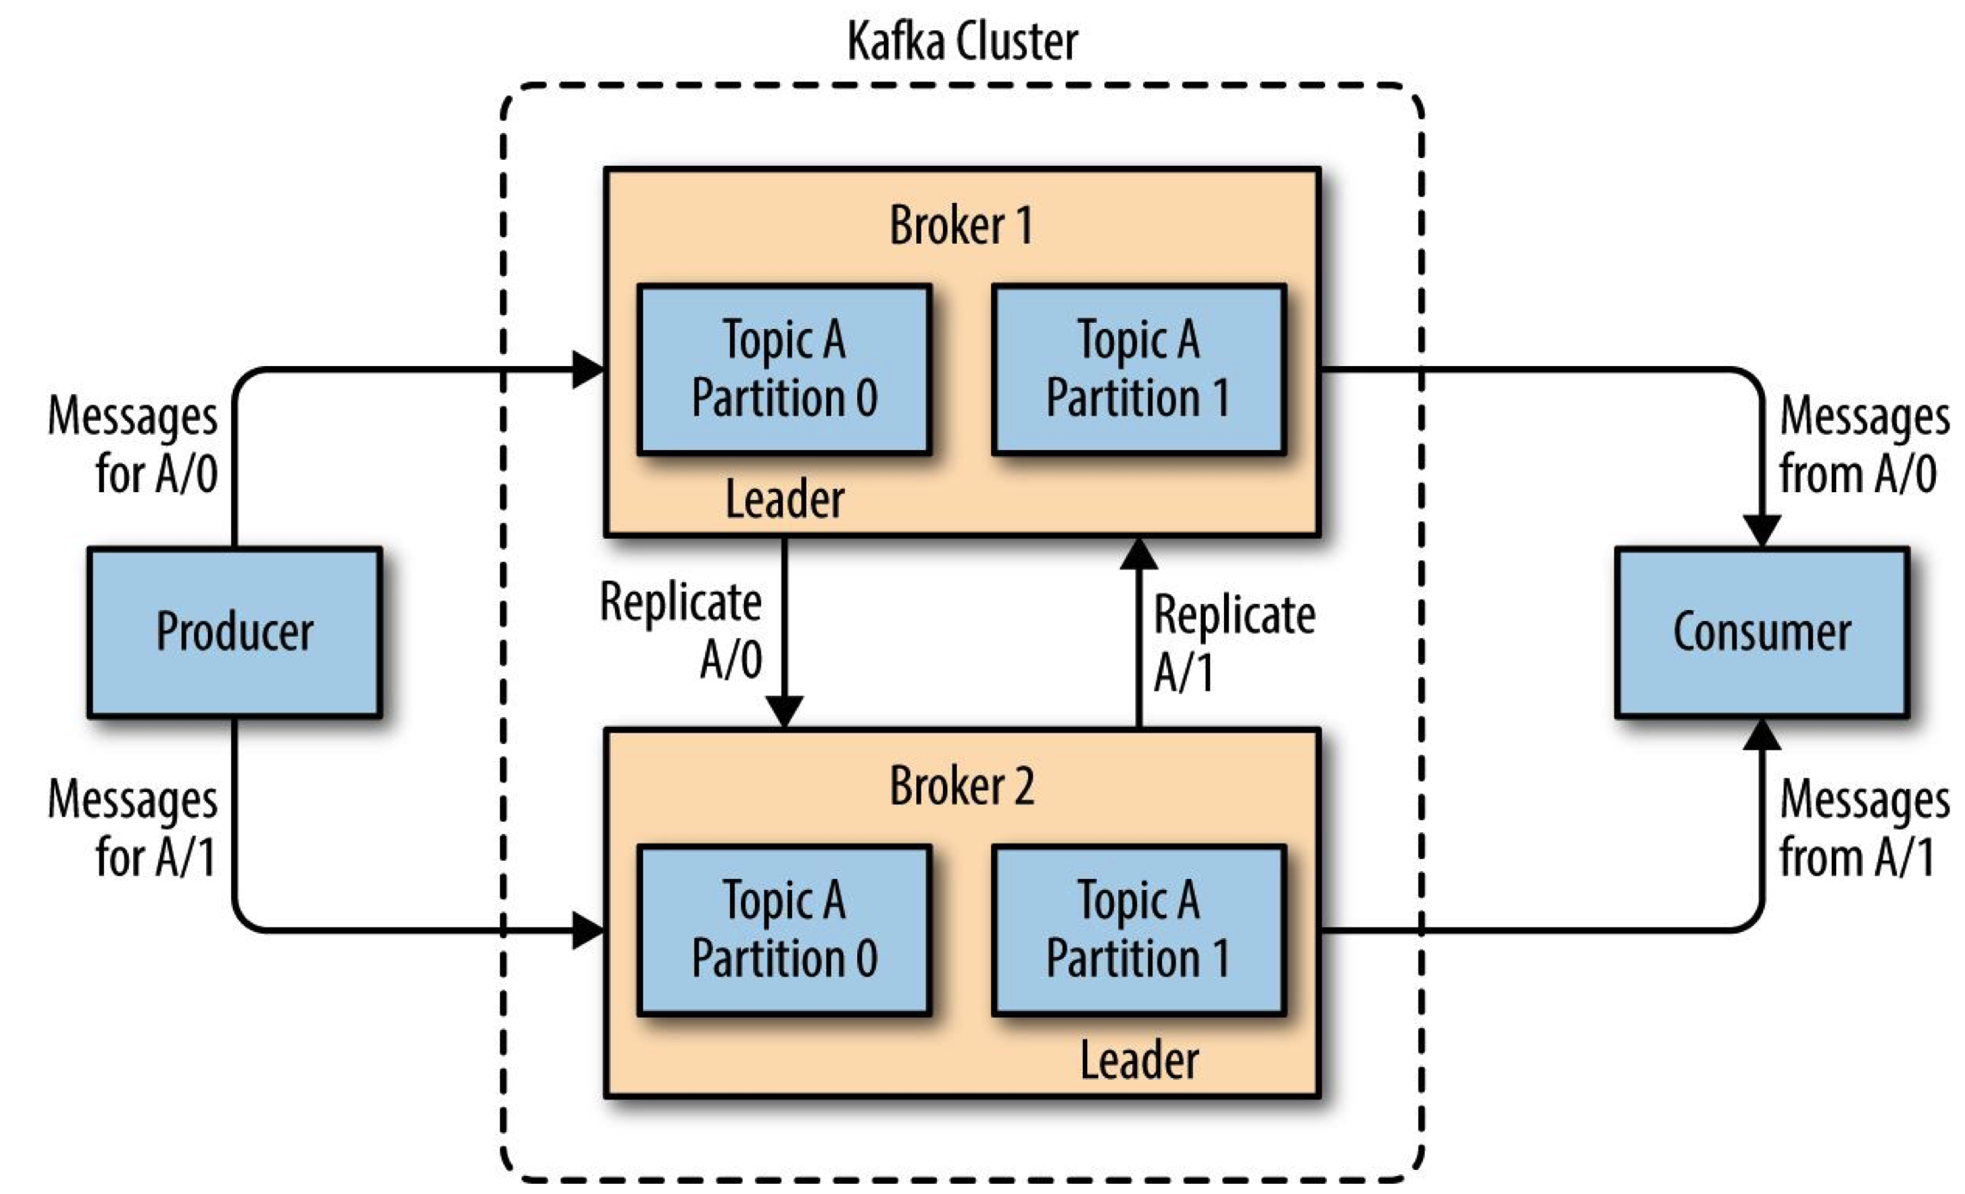
3 – Kafka Topic Partitions

Slide 33
3 – Kafka Partitions and offsets.
- Order is maintained only in a single partition
- A partition is ordered, immutable sequence of records that is
continually appended to a commit log.
- records in partitions are assigned sequential id number called the offset
- Offset identifies each record within the partition
- A topic partition must fit on the server that host it
- A topic can span many partitions hosted on many servers

Slide 34
3 – Kafka vs Aws Kinesis
- Kinesis Streams is equivalent to Kafka Core
- Kinesis Analytics is equivalent to Kafka Streams
- Kinesis Shard is equivalent to Kafka Partition
- Kinesis Analytics allows you to perform SQL like queries on data streams
- Kafka Streaming allows performing functional aggregations and mutations
- Kafka integrates well with Spark and Apache Flink which allows SQL like queries on streams

Slide 35
4. Cloud Computing types
Infrastructure as a Service (IaaS)
Contains the basic building blocks for cloud IT and typically provide access to networking features, computers and data storage space. IaaS gives you the highest level of flexibility.
Platform as a Service (PaaS)
Removes the need for your organization to manage the underlying infrastructure (usually hardware and operating systems) and allows you to focus on managing of your applications.
Software as a Service (SaaS)
Offers a completed product run and managed by the service provider. You do not have to think about how the service is maintained and only think about how that particular piece of software is going to be used.

Slide 36
4. Cloud Computing types
Infrastructure as a Service (IaaS)
Contains the basic building blocks for cloud IT and typically provide access to networking features, computers and data storage space. IaaS gives you the highest level of flexibility.
Platform as a Service (PaaS)
Removes the need for your organization to manage the underlying infrastructure (usually hardware and operating systems) and allows you to focus on managing of your applications.
Function as a Service & Serverless (FaaS)
Offers capability to call functions in the cloud. You do not have to think about how the service is maintained, scaled or recovered.

Slide 37
Computing Deployment models
- Cloud
- Hybrid
- In Premises

Slide 38
Computing Deployment models
Cloud
Applications are fully-deployed on the cloud, with all components running on it.
Applications on the cloud have either been created for the cloud or have been migrated from data-center to take advantage of the benefits of cloud computing.
They can be built on low-level services or use fully managed services. (more about this later…)

Slide 39
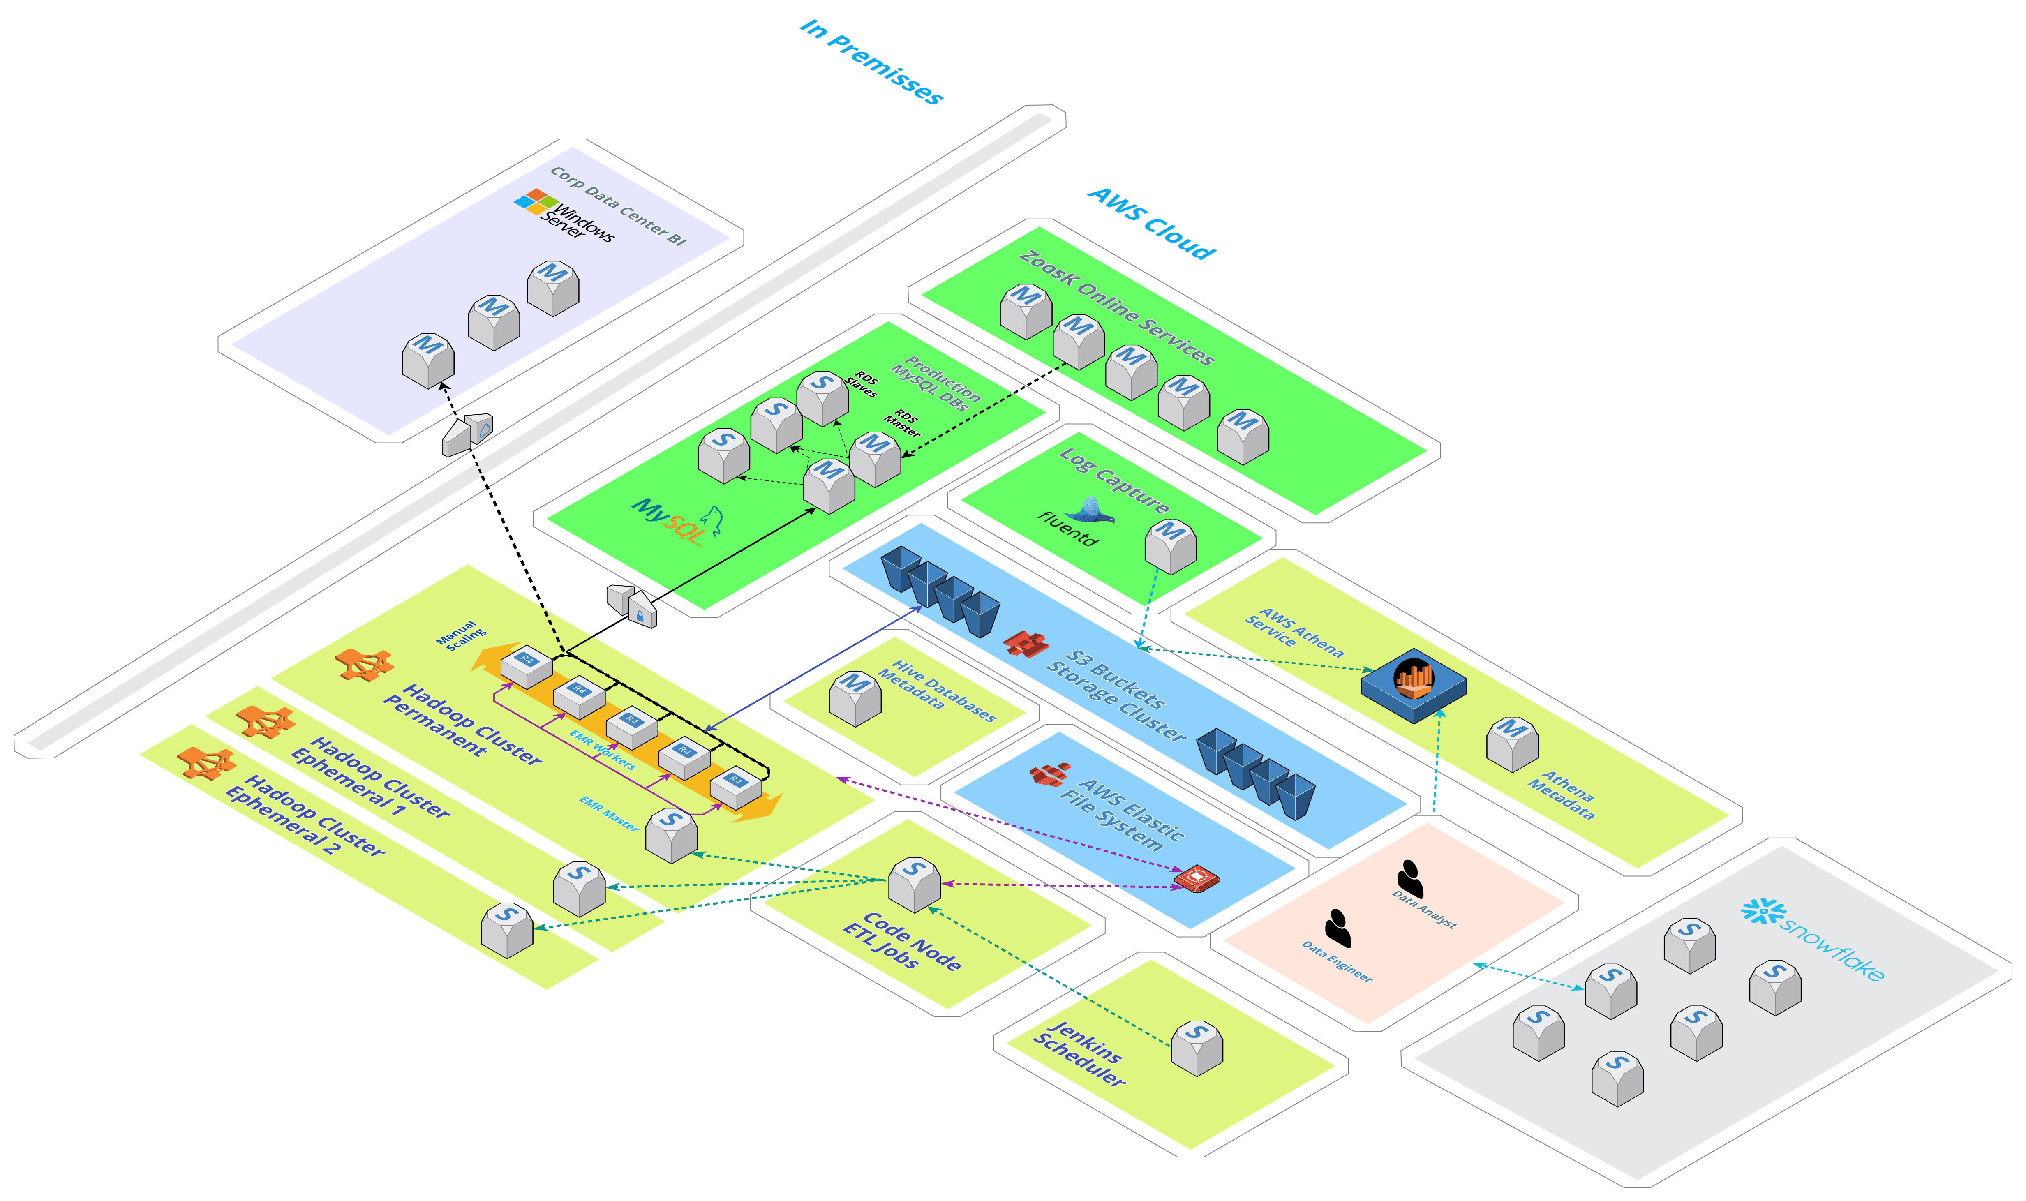
Example Data Architecture - Cloud

Slide 40
Computing Deployment models
Hybrid
The deployment of resources on-premises, using virtualization and resource management tools, is sometimes called the “private cloud.”
In-premises deployment doesn’t provide many of the benefits of cloud computing, but it can enable deployment of dedicated resources.
In most cases, this deployment model is the same as legacy IT infrastructure while using application management and virtualization technologies to optimize resource utilization.

Slide 41
Computing Deployment models
In Premises
It’s been the traditional way of building systems where company uses a datacenter and is responsible to buy, deploy and manage all the hardware.
This approach is very limited during re-architecting efforts. Also is expensive as companies need to plan to handle peaks.

Slide 42
Amazon EC2
Amazon Elastic Compute Cloud is a service that allows dynamically allocating “instances” of servers inside of the Amazon cloud.
There are hundreds of types of hosts with the most different hardware resources.
Once an instance is started your account is charged by the number of hours online.
For more details, take a look at:
https://www.ec2instances.info/

Slide 43
Amazon S3
Amazon Simple Storage Service (s3) is a service that allows storing massive amounts of data into a fully redundant infrastructure.
Data is represented as files and its possible to ‘simulate’ a hierarchical directory tree.
Data is globally available and secure.
There are several levels of performance and pricing on S3.
For more details take a look at:
https://aws.amazon.com/s3/

Slide 44
Amazon EMR
Amazon Elastic Map/Reduce is a service that allows creating Hadoop clusters with flexibility of components used and cluster capacity.
Clusters can be launched and kept running for many days.
Cluster can be created to execute a daily task in the morning,
compute the task and shut down.
Pay for the minutes the cluster nodes are running.
Note: There is a small additional cost creating and shutting down a cluster immediately.

Slide 45
Cloud Computing: Main Advantages
Facilitates SAAS (Software as a Service)
Simple deployment, simulation and upgrades.
Flexible capacity allocation.
No need to plan for peaks.
Always available
Redundancy is embedded from ground up.
Agile during Re-Architectural efforts
No need to commit to any hardware.
Easy to try new designs and measure cost benefit.
Enables Adding Managed Services offerings on top of basic services.
Amazon offers managed databases services (RDS) and managed Hadoop cluster services (EMR).

Slide 46
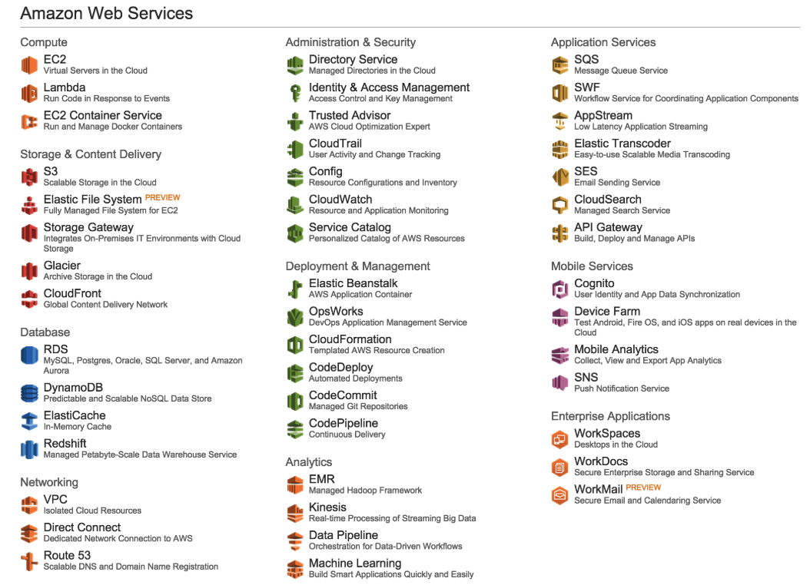
AWS – There are many services. Focus!

Slide 47
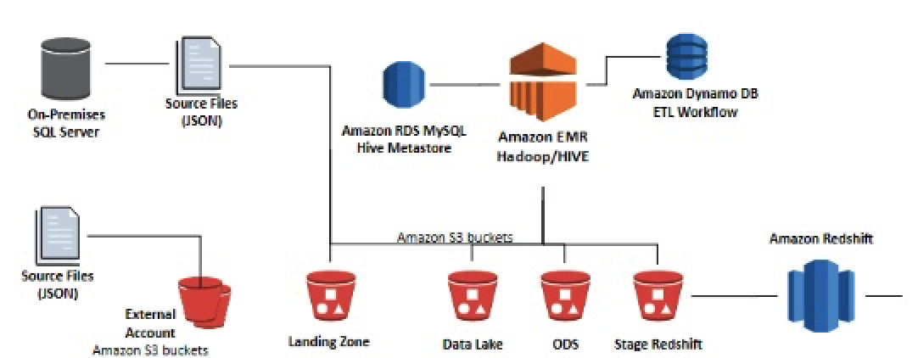
AWS for Big Data: EC2, EMR, S3 and DynamoDB
Hadoop YARN/Spark Cluster
Hadoop HDFS

Slide 48

4. Apache Airflow

Slide 49
Airflow - Terminology
DAG
Directed acyclic graph
Tasks
a DAG is composed of tasks
Operator
Building block to create tasks.
Task Instance
An specific parametrized run of task
Hooks
provide connectivity to external systems.
Connections
Keep the credentials independent of code.

Slide 50
Airflow - Terminology
Queues
Allow to allocate capacity
XComs
a channel to write and read data while running a DAG
Variable
Building block to create tasks.

Slide 51
Airflow - Operators
BashOperator - executes a bash command
PythonOperator - calls an arbitrary Python function
EmailOperator - sends an email
SimpleHttpOperator - sends an HTTP request
MySqlOperator, PostgresOperator,
MsSqlOperator, OracleOperator
- Connects to each of the databases.
JdbcOperator – executes SQK via jdbc connection

Slide 52
Airflow - Operators
DockerOperator – Interacts with docker containers
HiveOperator – execute hive queries
S3FileTransformOperator – Store files in S3
PrestoToMySqlTransfer – Transfer files from presto to MySQL
SlackAPIOperator – Send slack messages

Slide 53
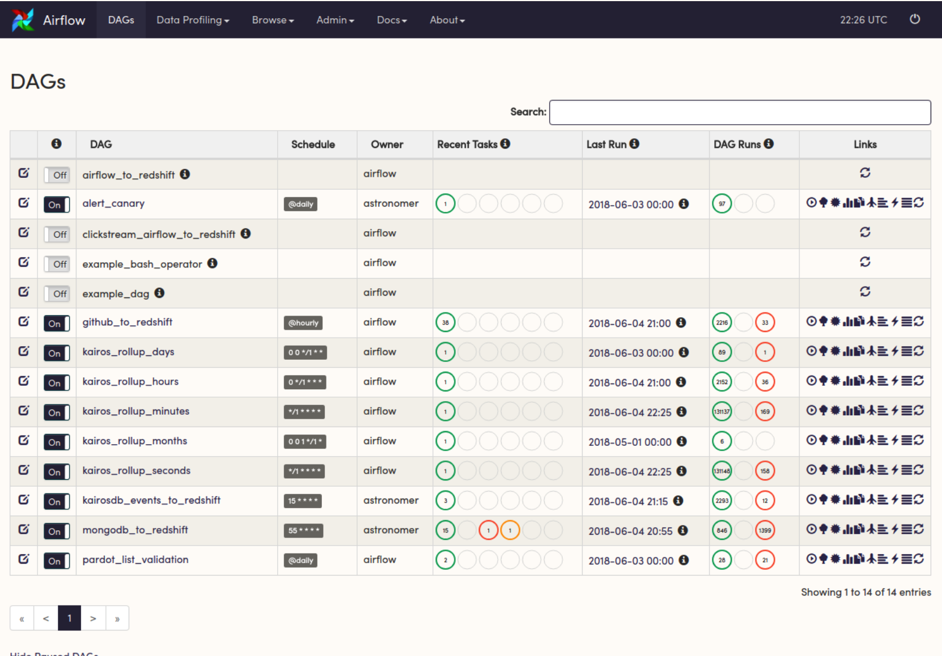
Airflow – Dags View

Slide 54
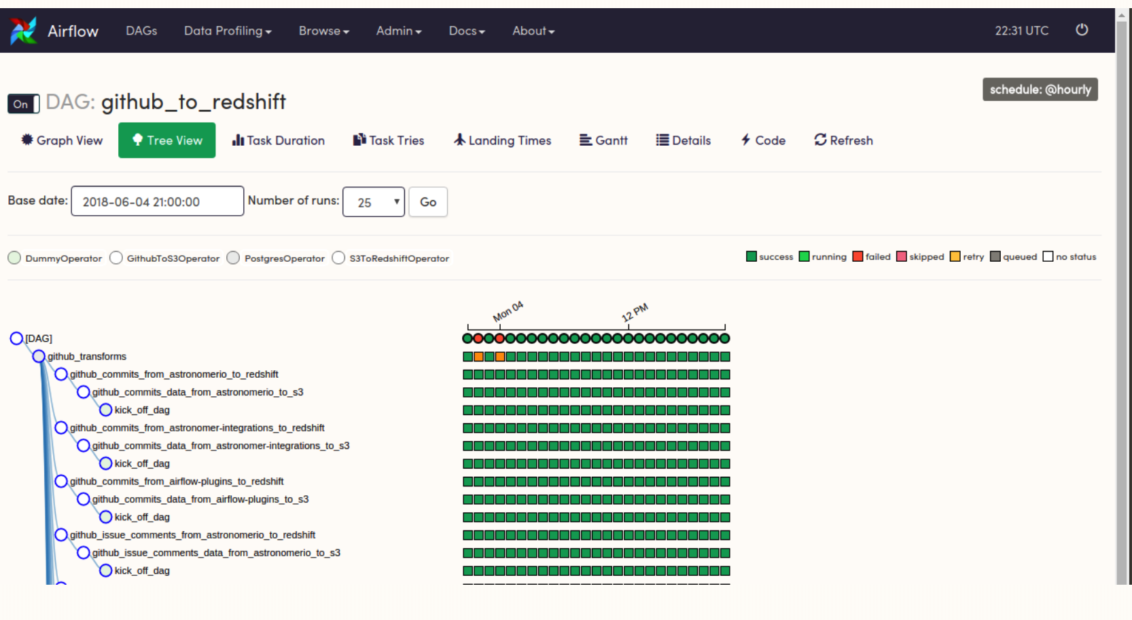
Airflow – Dag tree view

Slide 55
Airflow – Dag tree view

Slide 56
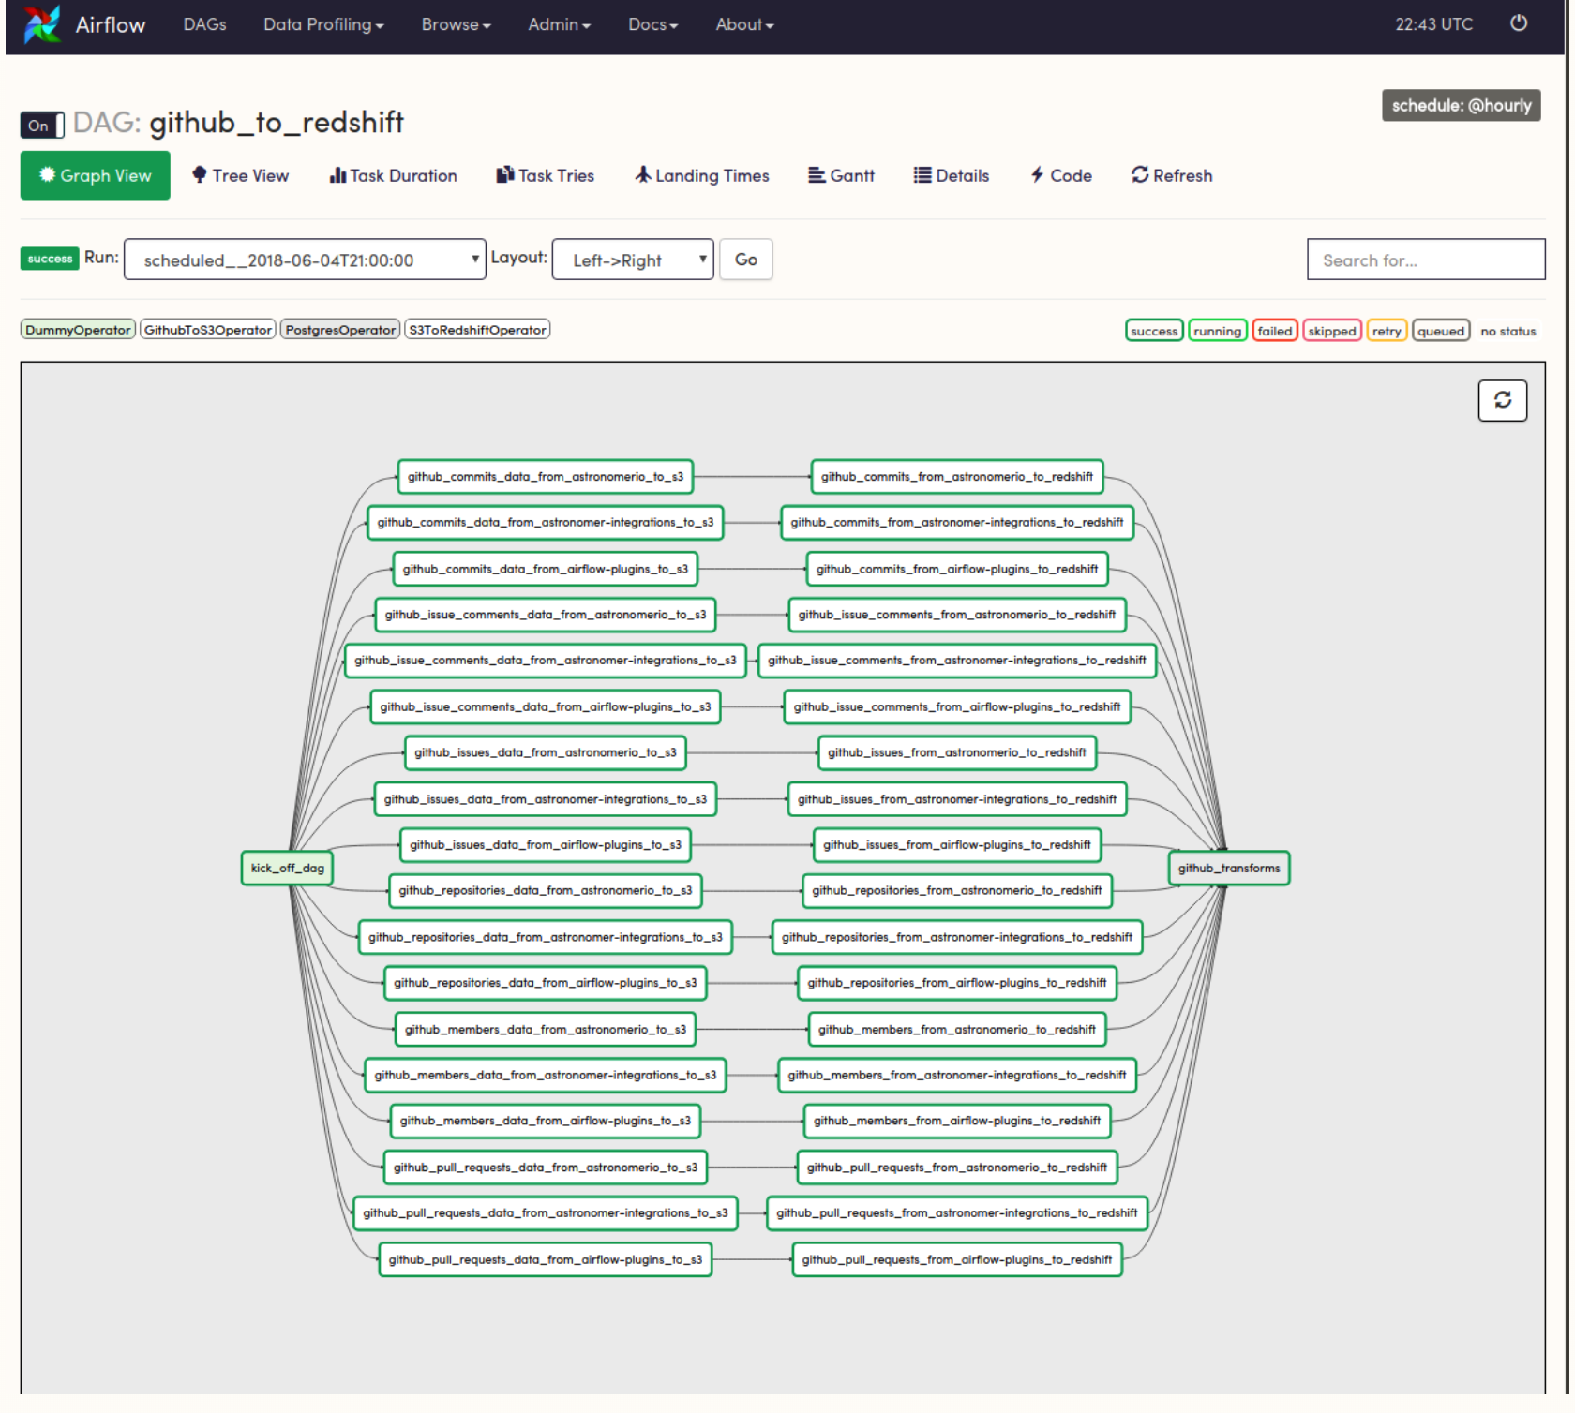
Airflow – Dag graph view

Slide 57
Airflow – Sample code
dag = DAG('my_dag', start_date=datetime(2019, 1, 1))
explicit_op = DummyOperator(task_id='op1', dag=dag)
deferred_op = DummyOperator(task_id='op2')
deferred_op.dag = dag
# equivalent operations
op1 >> op2
op1.set_downstream(op2)
# equivalent operations
op2 << op1
op2.set_upstream(op1)

Slide 58
ETL Design – Step to create a pipeline.
Step 1. Figure out the tables and schemas you need.
Step 2. Create each step in bash and test the manual process first.
Step 3. Integrate the commands into a orchertration tool (airflow or custom program).
Step 4. Perform end-to-end test using the deployed ETL.

